Slide 1

Distributed Energy Resource (DER) Integration into Wholesale Markets and Operations
  Overview and Current Needs
January 2022

Slide 2
The ESIG Report DER Integration into Wholesale Markets and Operations is focused on FERC Order 2222 and broader gaps
BACKGROUND
THE REPORT:
Introduces the concept of DERs and describes the trends in DER adoption, benefits of DERs, and interactions of DERs with wholesale markets and operations.
Provides an analytical framework for understanding the actors, market processes, and operator functions involved in DER market and system integration, as well as the existing and potential models for DER participation in wholesale markets.
Examines possible modes of operational coordination among distribution utilities, DER aggregators, and independent system operators and regional transmission organizations (ISOs/RTOs) to support the implementation of Order 2222.
Describes the broader gaps for integrating DERs into wholesale markets and operations, beyond Order 2222.
Recommends actions for state regulatory commissions, distribution utilities, and ISOs to address near-term gaps related to Order 2222 and broader gaps around DER market and system integration.

Slide 3
Distributed energy resources — generation, storage, and responsive load connected to distribution systems — can provide a range of benefits for customers, distribution systems, and wholesale markets
BACKGROUND
Customers
Distribution Systems
Wholesale Markets
CUSTOMERS
DERs can be customized to customers’ needs and preferences while defraying some of their costs by providing distribution-level and wholesale market benefits.
to customers’ needs and preferences while defraying some of their costs by providing distribution-level and wholesale market benefits.
DISTRIBUTION SYSTEMS
The effective siting and operation of DERs can reduce the need for distribution upgrades to support load growth, electrification, resilience to extreme weather, and increasing amounts of distribution-level generation.
WHOLESALE MARKETS
DERs can provide a new source of operational flexibility and competition, reducing energy and ancillary services market costs, resource adequacy capacity requirements, and transmission charges for load-serving entities.

Slide 4
Realizing the benefits of DERs requires closer coordination between the transmission and distribution systems
BACKGROUND
Distribution and transmission network infrastructure provides the foundation for electricity markets by enabling wholesale transactions and ensuring that networks can be reliably operated.
DER integration will require several changes in distribution and transmission planning, including:
    A more integrated approach to distribution planning, interconnection, and operations.
    Closer coordination between distribution and transmission planning.
Without coordination between the distribution and transmission systems, electricity systems risk being over- or underbuilt and will be increasingly challenging to operate, leading to high costs and potentially lower reliability.

Slide 5


Regulatory frameworks and market rules to support DER integration into wholesale markets are still in the early stages
BACKGROUND
Changes in market regulation are needed to support DER integration into wholesale markets, both for longer-term implementation of Order 2222 and to enable a broader set of structural participation models for DERs.
These changes include:
    Rules to ensure non-discriminatory distribution interconnection and operations.
    Resolution of issues around state-federal jurisdiction.

Slide 6

FERC Order 2222 and DER integration
BACKGROUND
FERC’s recent Order 2222 (September 2020) supports initial steps toward better integration of DERs into wholesale markets and operations. Order 2222 requires FERC-jurisdictional ISOs and RTOs to create participation models that will enable aggregations of DERs to participate in ISO/RTO energy, capacity, and ancillary services markets.
    Order 2222 recognized that DERs have the capability to provide wholesale market services — energy, capacity, and ancillary services — but many DERs are individually too small to meet ISO/RTO minimum size thresholds and may individually lack sufficient operational flexibility to meet performance requirements.
    Order 2222 enables the aggregation of DERs to address these limitations and enable DERs to participate in wholesale markets on a level playing field.

Slide 7
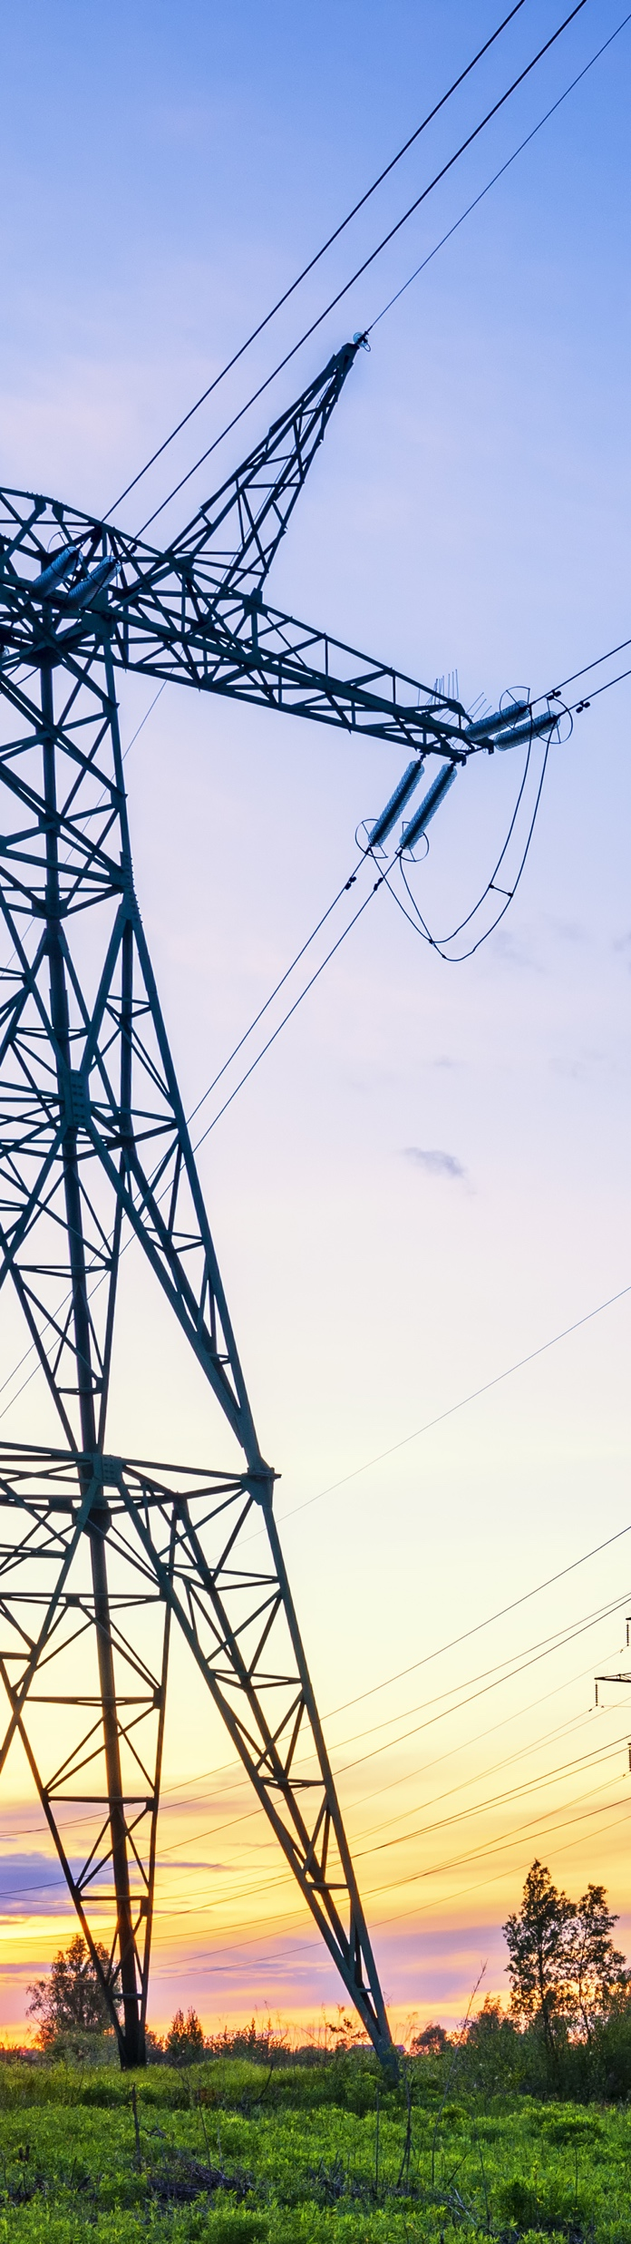
BACKGROUND
FERC Order 2222 and DER integration
(continued)
At the distribution level, many state regulatory commissions and distribution utilities are still in the early stages of developing approaches to comply with Order 2222.
It remains to be seen whether Order 2222 will unleash extensive participation of DER aggregations in wholesale markets.
    Currently, most DERs are compensated through retail programs, procurement, and tariffs, rather than through wholesale markets. In these arrangements, DER interactions are intermediated by utilities and other load-serving entities, which participate in ISO markets through demand bids and changes in metered demand rather than through supply offers.
    FERC Order 2222 enables supply-side participation by DERs, although it only covers one possible model of DER integration.
Order 2222 has triggered a national conversation that covers a broad spectrum of DER market and system integration issues. This is an important conversation to have as we move toward a future electric power system with high shares of renewables at all levels of the system.

Slide 8
Key areas and actions for regulatory commissions and distribution utilities to support FERC Order 2222 compliance
BACKGROUND
 | Actions Needed by Commissions | Actions Needed by Distribution Utilities
Interconnection procedures | Ensure that interconnection procedures are transparent, are fair, and conform to predictable costs and time frames | Develop new or enhance existing DER interconnection procedures to establish DER performance parameters (e.g., maximum injection limits) and utilities’ ability to curtail DER power injections for reliability purposes
DER aggregation review | Ensure that utility aggregation review is timely, fair, and flexible, avoiding the need for new interconnection studies | Develop transparent procedures for review within 60 days of an aggregator proposing a DER aggregation
Outage communication | Ensure that distribution utility outage communication is timely and fair, allowing DER providers to manage non-performance risks in the wholesale market | Develop new processes and capabilities for communicating distribution outages or constraints to DER aggregators
Utility overrides | Ensure that distribution utility overrides are transparent and non-discriminatory | Develop transparent, non-discriminatory procedures for overriding ISO/RTO scheduling and dispatch of DERs that align with expectations set within the aggregation review process

Slide 9
Findings and Recommendations

Slide 10
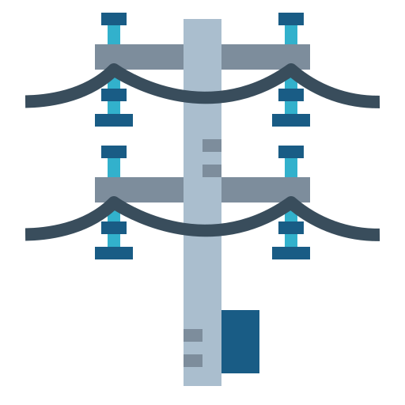


Broader gaps for DER market and system integration beyond Order 2222
FINDINGS + RECOMMENDATIONS
TRANSMISSION AND
DISTRIBUTION PLANNING
Integrate approach to distribution planning, interconnection, and operations
Increase coordination between distribution and transmission planning
DISTRIBUTION INTERCONNECTION
Determine setpoint guidance for smart inverters, given distribution systems’ needs
Define how utilities should determine minimum reliability upgrades versus upgrades that could be avoided through DER curtailment or re-dispatch
Determine how utilities ensure that procedures for curtailing or re-dispatching flexible interconnections are transparent and non-discriminatory
DISTRIBUTION OPERATIONS
Identify least-regrets enhancements in visibility, communications, DER operations, and real-time controls that will be needed
Allocate responsibilities for active coordination of DER activity between the distribution system operator and the ISO/RTO

Slide 11


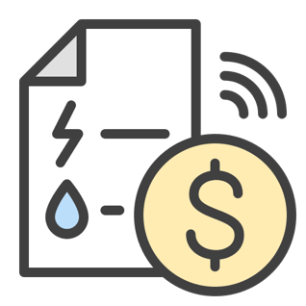

Broader gaps for DER market and system integration beyond Order 2222
FINDINGS + RECOMMENDATIONS
Broader gaps for DER market and system integration beyond Order 2222 (continued)
COMMUNICATIONS AND DATA-SHARING
Enable increased communication between distribution utilities or distribution system operators and ISOs/RTOs, including during day-ahead and intraday scheduling, real-time dispatch, automatic generation control signals, and emergency operations
Increase available information on loads, anticipated load growth, and DERs in the interconnection queue
MARKET REGULATION
Ensure that distribution operators’ overrides of DER schedules and dispatch and dispatch of DERs are transparent and non-discriminatory
Clarify issues around state-federal jurisdiction
UTILITY REGULATION AND
BUSINESS MODELS
Implement incentive frameworks that attempt to better align utility incentives with maximizing the system value of DERs
Design tariffs to incentivize the flexibility that can be provided through energy storage and load management
ISO/RTO MARKET DESIGN
Implement market design changes to enable market-based approaches to load participation during the operating day

Slide 12
Recommendations to enable DER integration in wholesale markets
FINDINGS + RECOMMENDATIONS
For ISOs/RTOs at an early stage of DER integration, issues around FERC Order 2222 implementation and the list of gaps may appear complex. The strategies below can help state regulatory commissions, utilities, and ISOs/RTOs navigate next steps.
START WITH MINOR CHANGES. Begin from an assumption that relatively minor changes in distribution planning, distribution operations, and utility investments in monitoring and controls necessary to support them will be needed for near-term compliance with Order 2222 (commissions, utilities).
1
LEVERAGE EXISTING DATA. Leverage data from DER registration and interconnection in DER aggregation reviews to minimize the need for additional study during reviews; in most cases, DER aggregation review should not require redoing interconnection studies (commissions, utilities).
2
USE EXISTING PROCESSES FOR COMMUNICATIONS AND DATA-SHARING. Rather than create new processes and additional complexity, make use of existing protocols and processes for communications and data-sharing among utilities, aggregators, and ISOs/RTOs (utilities, DER aggregators, ISOs/RTOs).
3

Slide 13
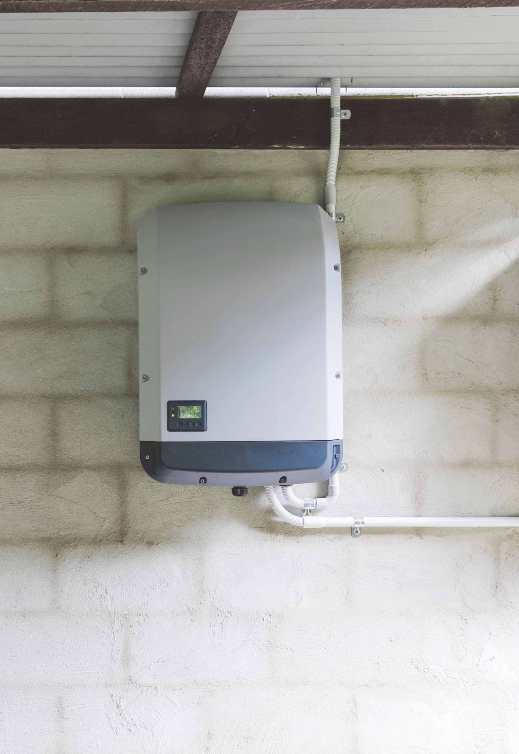
FINDINGS + RECOMMENDATIONS
Recommendations to enable DER integration in wholesale markets (continued)
4
  DEVELOP WORKABLE APPROACHES TO UTILITY OVERRIDES. Focus initially on developing workable approaches to utility overrides, based on a foundation of efficient communication between utilities and aggregators, with terms and conditions that are clearly articulated in interconnection and aggregator agreements and can evolve over time (utilities, commissions, aggregators).
  PRIORITIZE ADOPTION AND IMPLEMENTATION OF IEEE 1547-2018. Voltage support provided through compliance with interconnection standards may reduce the need for overrides and distribution upgrades (commissions, utilities).
5
  PARTICIPATE IN NATIONAL, INDUSTRY-WIDE DIALOGUE. Begin or be a part of broad conversations on forward-looking issues where solutions can be accelerated through joint, creative problem-solving and the development of a set of nation-wide best practices.
6

